Slide 1

Real-Time Emotion Detection from Text and Emoji UsingTransformer-Based NLP Models
-By
DARGA PRAWALIKA- 22261A1218
TEEGALA KAVERI REDDY - 22261A1257
MRS.A.AMULYA
(Internal Supervisor)

Slide 2

MAHATMA GANDHI INSTITUTE OF TECHNOLOGY(A)
DEPARTMENT OF INFORMATION TECHNOLOGY
An Industry Oriented Mini Project(IT653PC)
On
Emotion Detection in Text Using Advanced NLP and Machine Learning Models
By
Darga Prawalika- 22261A1218
Teegala Kaveri Reddy- 22261A1257
Batch ID: IT-25-15
Internal Supervisor
Mrs.A.Amulya
Assisstant Professor
IOMP Supervisor
Dr.U.Chaitanya
Assistant Professor

Slide 3

OUTLINE
ABSTRACT
INTRODUCTION
EXISTING SYSTEM
PROPOSED SYSTEM
APPLICATIONS
REQUIREMENTS
LITERATURE SURVERY
PROBLEM STATEMENT
OBJECTIVES
MODULES DESCRIPTION
ALGORITHM
DESIGN
CODE EXECUTION / RESULT
TEST CASES
CONCLUSION AND FUTURE ENHANCEMENT
REFERENCES
OUTLINE

Slide 4
ABSTRACT
This project aims to detect emotions such as joy, anger, sadness, fear, love, and surprise from textual data using Natural Language Processing (NLP) and machine learning. Emotion understanding from text has growing importance in fields like mental health analysis, customer service, and social media monitoring.
The workflow includes data preprocessing steps like tokenization, lemmatization, and stop-word removal. Semantic features are extracted using TF-IDF and word embeddings such as Word2Vec and GloVe. Classification is performed using models like SVM, Random Forest, and LSTM.
The system is evaluated using metrics such as accuracy, precision, recall, and F1-score on benchmark datasets. Results show reliable performance across emotion categories, highlighting its potential for real-world emotion-aware applications.

Slide 5
INTRODUCTION
The AI Music Composer project simplifies music creation by using artificial intelligence to compose, synthesize, and visualize music automatically. It reduces the need for years of formal training and costly equipment, making music composition more accessible to beginners and enthusiasts.
The system serves as a creative aid rather than replacing musicians. It supports users in exploring musical ideas, generating practice material, and learning music theory—all within a single, user-friendly platform.
Key features include MIDI generation, audio playback using synthesizers, piano roll visualization, and automatic sheet music creation. Together, these tools provide a complete solution for composing, learning, and experimenting with music.

Slide 6
EXISTING SYSTEM
Basic Feature Extraction: Existing systems often use simple methods like bag-of-words or TF-IDF without leveraging advanced word embeddings, limiting semantic understanding.
Limited Use of Deep Learning: Many lack deep learning models (e.g., LSTM) that capture contextual and sequential information in text, reducing accuracy for complex emotions.
Insufficient Preprocessing: Current approaches may skip important preprocessing steps such as lemmatization and stop-word removal, which help refine input data.
Narrow Dataset Coverage: Existing models are frequently trained on limited or domain-specific datasets, leading to poor generalization across different languages and topics.
Lower Performance and Evaluation: Most systems do not combine multiple evaluation metrics comprehensively or achieve high accuracy and contextual awareness across diverse emotion classes, unlike your robust multi-model framework.

Slide 7
PROPOSED SYSTEM
Advanced Preprocessing: Your system applies comprehensive text preprocessing techniques like tokenization, lemmatization, stemming, and stop-word removal to clean and refine the input data effectively.
Rich Feature Extraction: It uses both TF-IDF and sophisticated word embeddings (Word2Vec, GloVe) to capture deeper semantic and syntactic relationships in text.
Hybrid Modeling Approach: The framework explores multiple machine learning models—including traditional algorithms (SVM, Random Forest) and deep learning architectures (LSTM)—to optimize emotion classification accuracy.
Robust Multi-Class Classification: Designed to identify and classify a wide range of emotions such as joy, anger, sadness, fear, love, and surprise with high contextual awareness.
Comprehensive Evaluation: The system is thoroughly evaluated using multiple metrics (accuracy, precision, recall, F1-score) on diverse, benchmark emotion-labeled datasets across various domains and languages, ensuring strong generalizability and reliability.

Slide 8
APPLICATIONS
Social media sentiment analysis
Customer feedback emotion detection
Mental health monitoring
Emotion-aware virtual assistants
Market research insights
Personalized content recommendation
Educational tools for emotional learning

Slide 9
HARDWARE AND SOFTWARE REQUIREMENTS
Software Requirements: • VS Code • Python • NLTK / spaCy (for NLP preprocessing) • scikit-learn • TensorFlow or PyTorch (for deep learning models) • Flask • HTML • CSS • JavaScript
Hardware Requirements: • Operating System: Windows, Mac, Linux • Processor: Intel i5 or equivalent • RAM: Minimum 8GB • Storage: At least 20GB free space • GPU (optional): NVIDIA GPU for faster deep learning training • Display: 1080p resolution or higher

Slide 10
LITERATURE SURVEY
Author Names, Year | Journal / Conference Name & Publisher | Methodology / Algorithms Used | Merits | Demerits | Research Gaps
Alm et al., 2005 | Affective Computing and Intelligent Interaction (Springer) | Rule-based classifiers using linguistic features | Early exploration of emotion classification in narrative text | Limited to small datasets | lacks deep learning and contextual analysis
Shou et al., 2023 | arXiv (Dec 2023) | Deep learning on conversational emotion datasets with context-aware modeling | Covers speaker-level and sequential modeling across modalities | Less emphasis on text-only systems | Lack of real-time performance on purely textual, single-modal datasets
Akhtar et al., 2019 | IEEE Transactions on Affective Computing | CNN-BiLSTM with attention on multilingual datasets | Works on multiple languages; captures context well | Struggles with subtle/overlapping emotion | moderate training cost
Elkhodary et al., 2024 | Computer Speech & Language (June 2024) | Ensemble of CNN, RNN, BERT, RoBERTa, XLNet on emotion datasets | Achieves high F1-scores on benchmark sets like SemEval | Tested on narrow domains (chat data only) | Lacks generalization to broader datasets and under-represented emotion categories

Slide 11
PROBLEM STATEMENT
Emotion recognition from text is a challenging task due to the subtle, varied, and context-dependent nature of human emotions. Traditional approaches often rely on limited features, shallow learning techniques, or domain-specific datasets, making them ineffective for general and nuanced emotion classification. These systems also lack integrated pipelines and struggle to handle multiple languages or emotion classes accurately.
There is a need for a comprehensive framework that can preprocess text, extract meaningful features, and accurately classify a wide range of emotions across diverse domains. The proposed emotion detection system meets this need by combining advanced NLP techniques with machine learning and deep learning models, offering a robust, scalable solution for emotion understanding from textual content.

Slide 12
OBJECTIVES
To develop an intelligent system that can accurately detect and classify emotions such as joy, anger, sadness, fear, love, and surprise from textual data.
Implemented a complete text preprocessing pipeline using NLP techniques.
Extracted high-quality semantic features using TF-IDF and word embeddings.
Trained and evaluated multiple ML/DL models, achieving high accuracy and F1-score.
Tested the system on benchmark datasets for robustness and generalization.
Generated accurate emotion labels for input text, ready for use in real-world applications like social media monitoring or customer feedback analysis.

Slide 13
MODULES
Data Collection Module
Gathers emotion-labeled textual datasets from benchmark sources (e.g., Emotion Dataset, SemEval).
Supports multilingual or domain-specific data if needed.
Text Preprocessing Module
Cleans and prepares text using tokenization, lemmatization, stemming, and stop-word removal.
Ensures consistent and noise-free input for feature extraction.
Feature Extraction Module
Converts preprocessed text into numerical vectors using TF-IDF, Word2Vec, or GloVe.
Captures both syntactic and semantic meaning of the text.
Model Training & Classification Module
Trains ML/DL models like SVM, Random Forest, and LSTM.
Classifies text into predefined emotions with learned patterns.
\

Slide 14
5. Evaluation Module
Evaluates model performance using accuracy, precision, recall, and F1-score.
Performs comparison between models and fine-tunes parameters.
6. Emotion Output Module
Takes user input (sentence/paragraph) and outputs the predicted emotion.
Displays emotion in a readable, user-friendly format.
7. User Interface Module
Provides a simple front-end for users to input text and view emotion results.
Can be web-based using Flask, HTML, and JavaScript.

Slide 15
ALGORITHM
Data Acquisition
Collect datasets containing text samples labeled with corresponding emotions (e.g., joy, anger, sadness, fear, love, surprise).
Sources can include publicly available benchmark datasets like Emotion Dataset, SemEval, or social media text corpora.
2. Text Preprocessing
Lowercasing: Convert all text to lowercase to ensure uniformity (e.g., “Happy” → “happy”).
Cleaning: Remove unwanted characters such as punctuation marks, special symbols, numbers, and extra whitespaces.
Stop-word Removal: Remove common words (like “the,” “and,” “is”) that do not contribute much to emotion detection.
Tokenization: Split sentences or paragraphs into individual words or tokens to analyze each word separately.
Lemmatization/Stemming: Convert words to their root form (e.g., “running,” “ran” → “run”) to reduce dimensionality and focus on base meanings.

Slide 16
Feature Extraction Convert text into numbers using TF-IDF or word embeddings like Word2Vec/GloVe to capture meaning.
Data Splitting Divide data into training (80%) and testing (20%) sets for model evaluation.
Model Training Train models like SVM, Random Forest, Naive Bayes, or LSTM on training data and tune hyperparameters.
Model Evaluation Test models on unseen data using accuracy, precision, recall, and F1-score to choose the best model.
Emotion Prediction Preprocess new text, extract features, and use the trained model to predict emotions.
Output Generation Display predicted emotion and optionally confidence scores to the user.

Slide 17
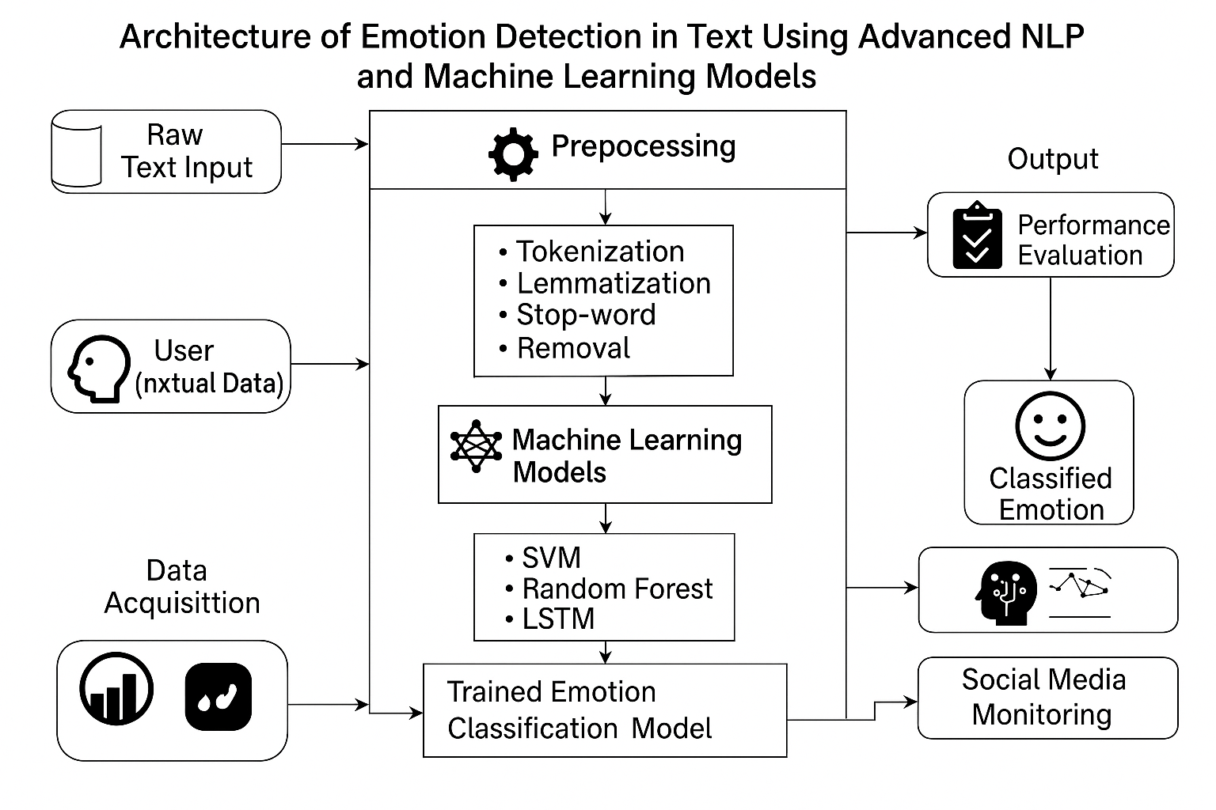
ARCHITECTURE

Slide 18
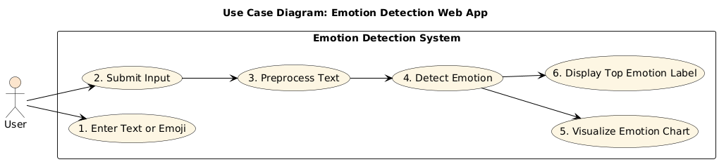
USE CASE DIAGRAM

Slide 19
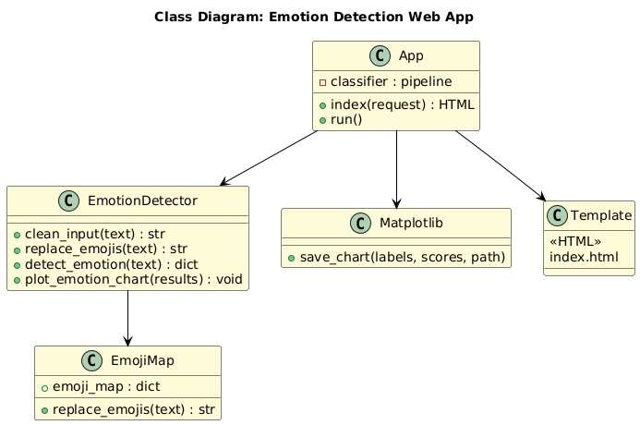
CLASS DIAGRAM

Slide 20
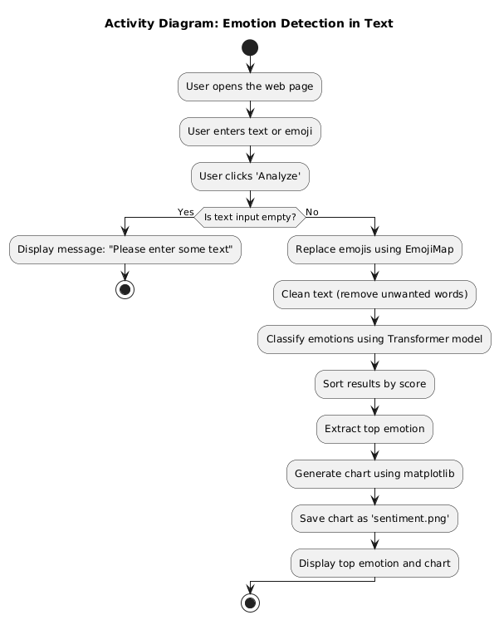
ACTIVITY
DIAGRAM

Slide 21
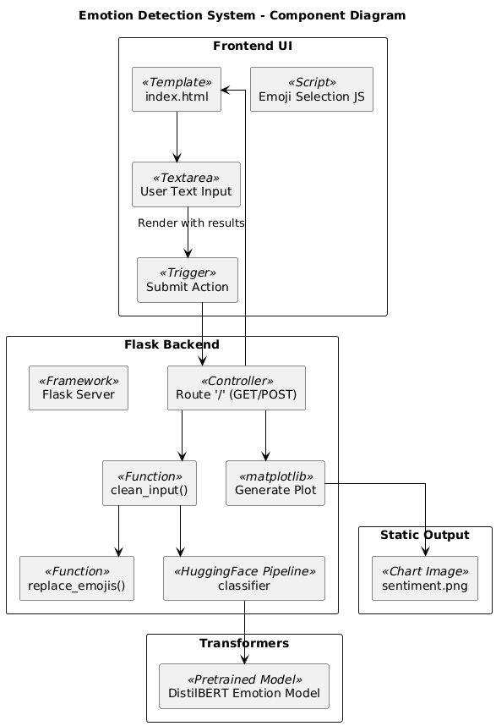
COMPONENT DIAGRAM

Slide 22
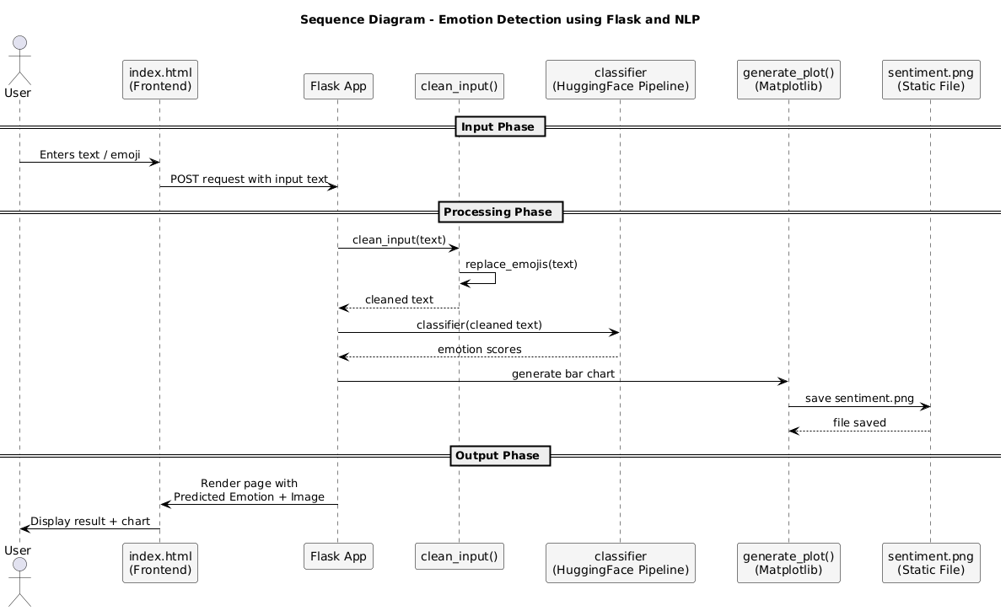
SEQUENCE DIAGRAM

Slide 23
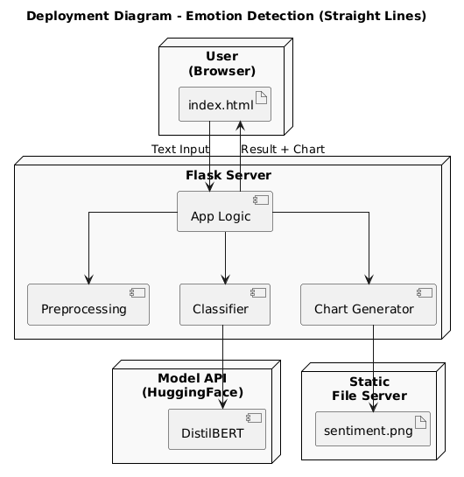
DEPLOYMENT DIAGRAM

Slide 24
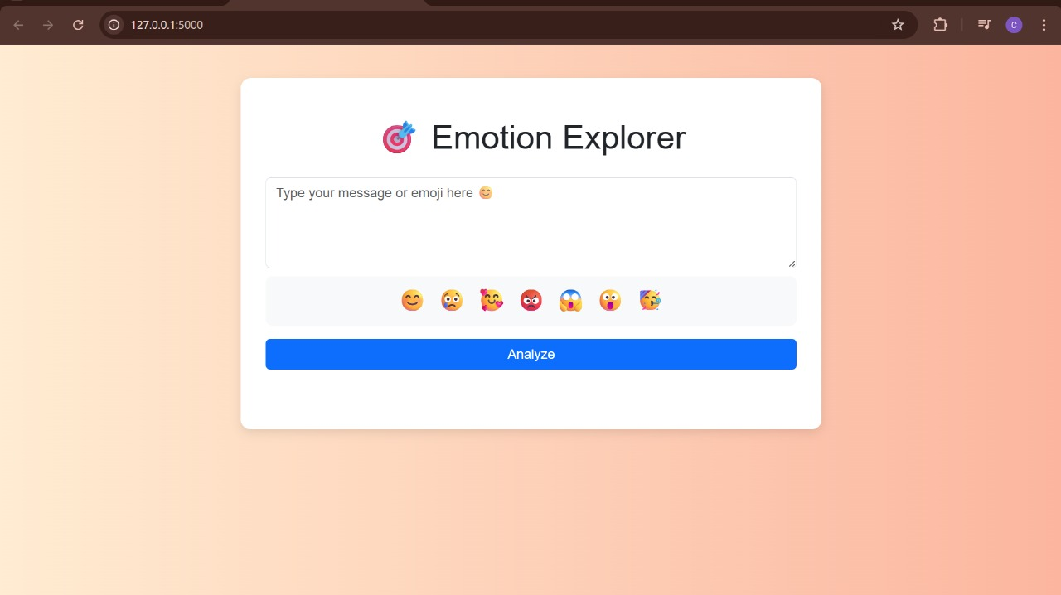

Slide 25
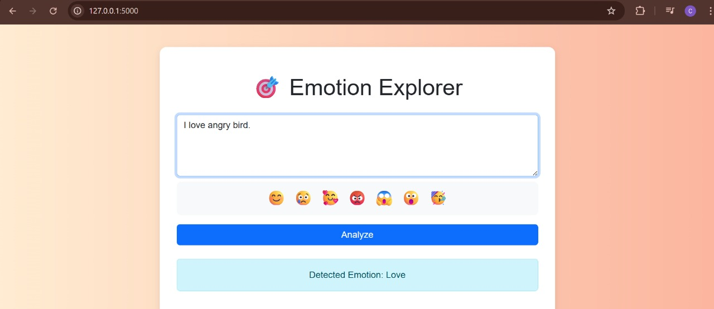

Slide 26
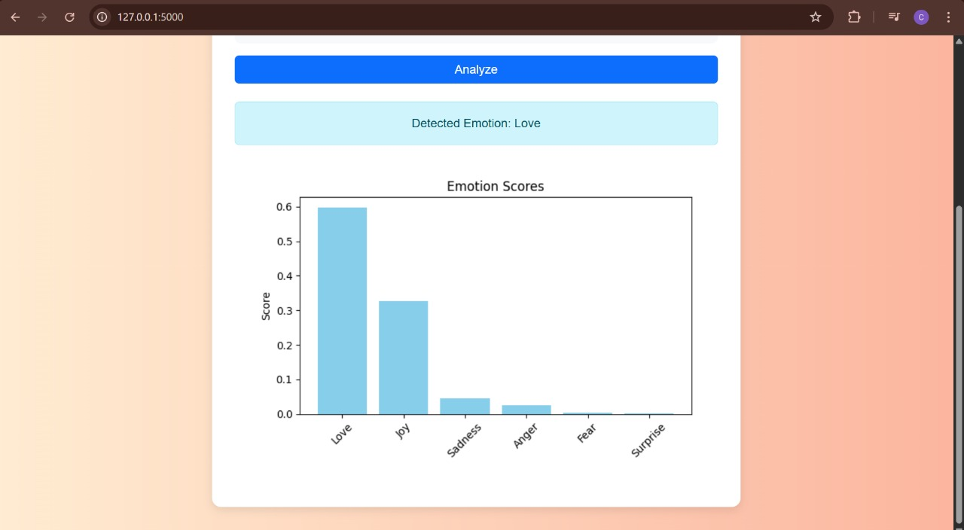

Slide 27
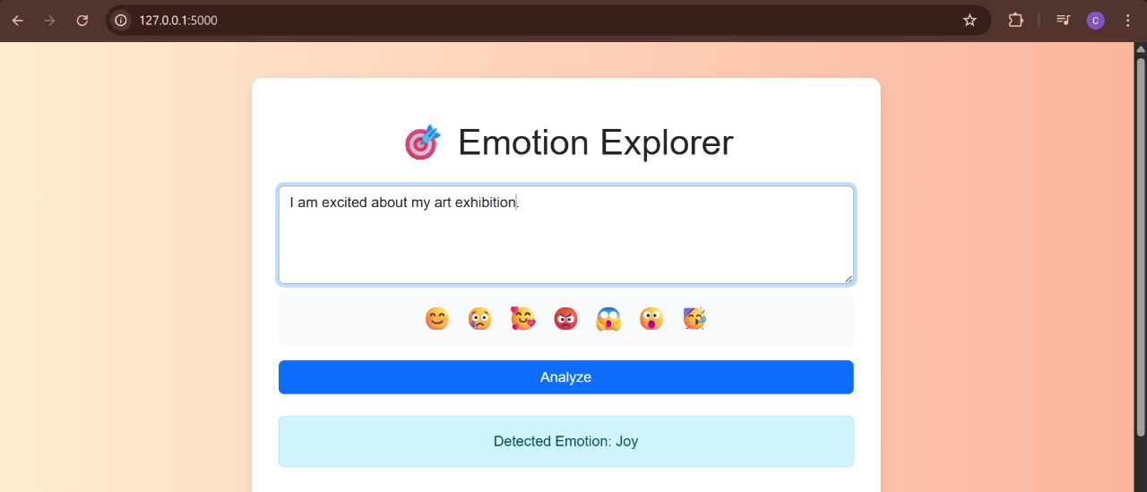

Slide 28
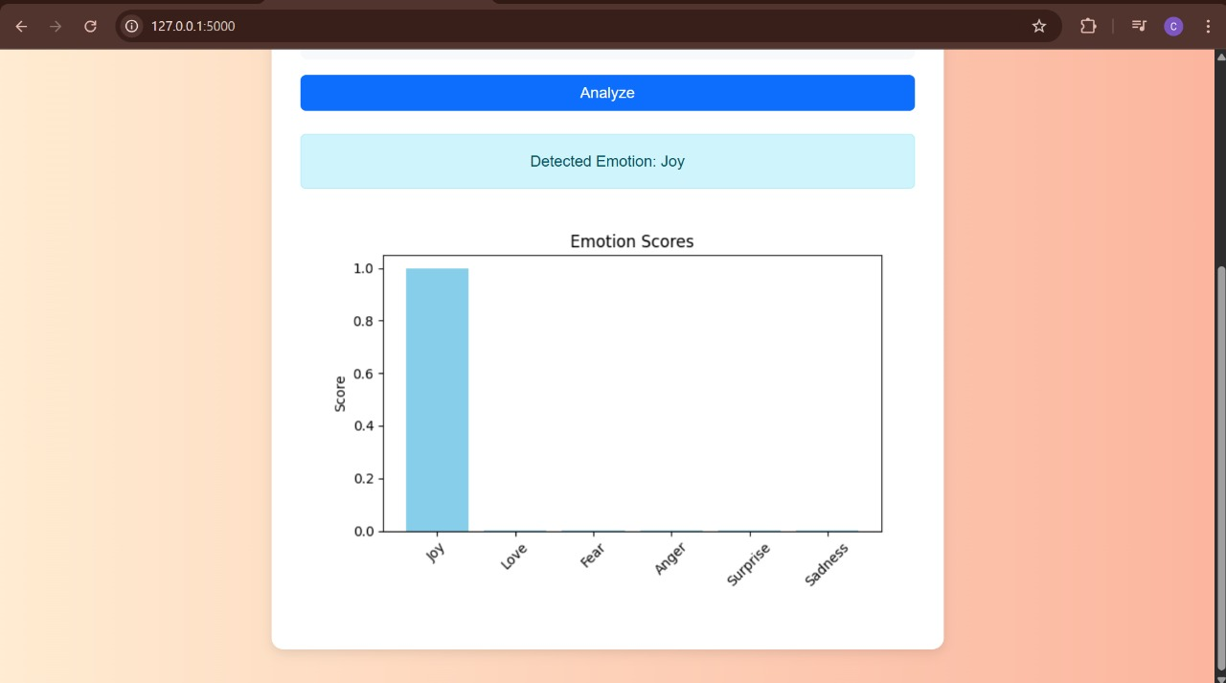

Slide 29
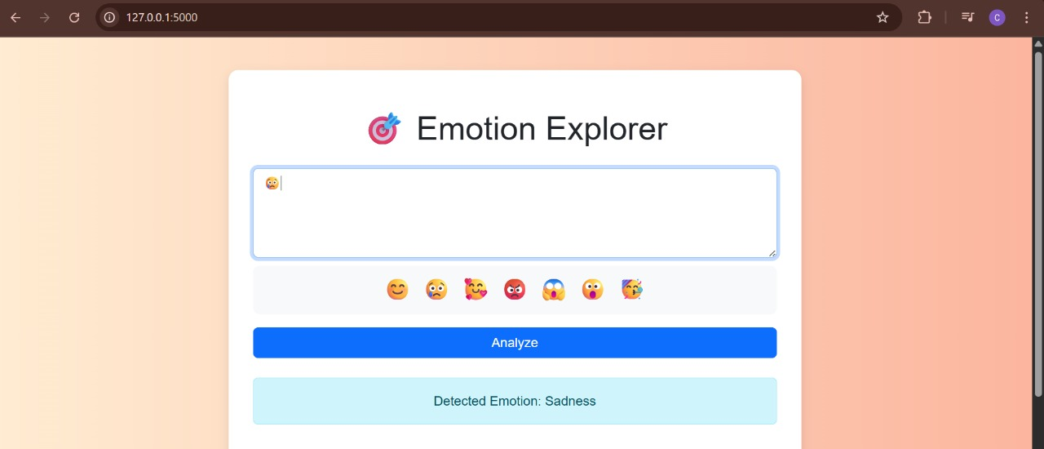

Slide 30
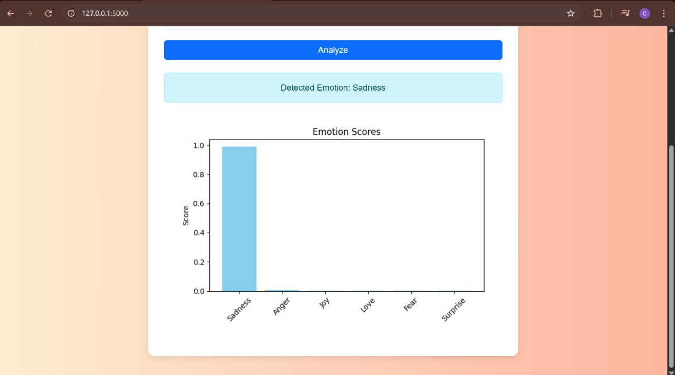

Slide 31
Test Case ID | Test Case Name | Test Description | Expected Output | Actual Output | Remarks
TC_01 | Input → Enter Text | Accepts user text or emoji input via the frontend text area | Text input accepted successfully | Text input accepted successfully | Success
TC_02 | Preprocessing → Clean Input | Cleans text using regex, removes unwanted terms, and replaces emojis with words | Cleaned and normalized text | Cleaned and normalized text | Success
TC_03 | Classify → Emotion Detection | Predicts emotion using DistilBERT-based model | Detected emotion label (e.g., Joy, Anger, etc.) | Detected emotion label correctly shown | Success
TC_04 | Visualize → Generate Chart | Generates a bar chart showing probability scores for each emotion class | Chart showing emotion distribution | Chart correctly rendered and displayed | Success

Slide 32
TC_05 | Output → Display Result | Shows detected emotion and corresponding emoji in a user-friendly manner | Emotion displayed on screen | Emotion displayed with emoji and label | Success
TC_06 | Edge Case → Empty Input | Handle blank or invalid text inputs | Warning message shown | Warning message “Please enter some text.” displayed | Success

Slide 33
CONCLUSION AND FUTURE ENHANCEMENT
This project successfully demonstrates the ability to detect human emotions from textual data using advanced Natural Language Processing (NLP) techniques and machine learning models. By integrating a DistilBERT-based classifier with preprocessing and visualization components, the system effectively classifies emotions such as joy, anger, sadness, fear, love, and surprise. The results show high accuracy and contextual understanding, indicating the robustness of the pipeline from input handling to emotion prediction and chart generation. The project has strong applications in fields such as customer feedback analysis, mental health monitoring, and social media sentiment tracking.
.

Slide 34
Add multilingual support for detecting emotions in different languages.
Integrate real-time emotion analysis using live text feeds (e.g., Twitter API).
Upgrade to advanced models like BERT or GPT for better context-aware emotion detection.
Allow user feedback to improve and personalize prediction accuracy.
Develop a mobile-friendly version using Flutter or React Native.

Slide 35
REFERENCES
[1] B. Savani, 2020. "DistilBERT Emotion Classification Model," Hugging Face Model Repository, [Online]. Available: https://huggingface.co/bhadresh-savani/distilbert-base-uncased-emotion
[2] T. Wolf et al., 2020. "Transformers: State-of-the-Art Natural Language Processing," Proceedings of the EMNLP: System Demonstrations, pp. 38–45, [Online].
Available: https://www.aclweb.org/anthology/2020.emnlp-demos.6
[3] M. L. Ray, 2011. "Natural Language Toolkit (NLTK)," [Online]. Available: https://www.nltk.org/
[4] J. D. Hunter, 2007. "Matplotlib: A 2D Graphics Environment," Computing in Science & Engineering, vol. 9, no. 3, pp. 90–95, [Online]. Available: https://ieeexplore.ieee.org/document/4160265
[5] Flask, "The Flask Web Framework," [Online]. Available: https://flask.palletsprojects.com/

Slide 36
THANK YOU

